Slide 1
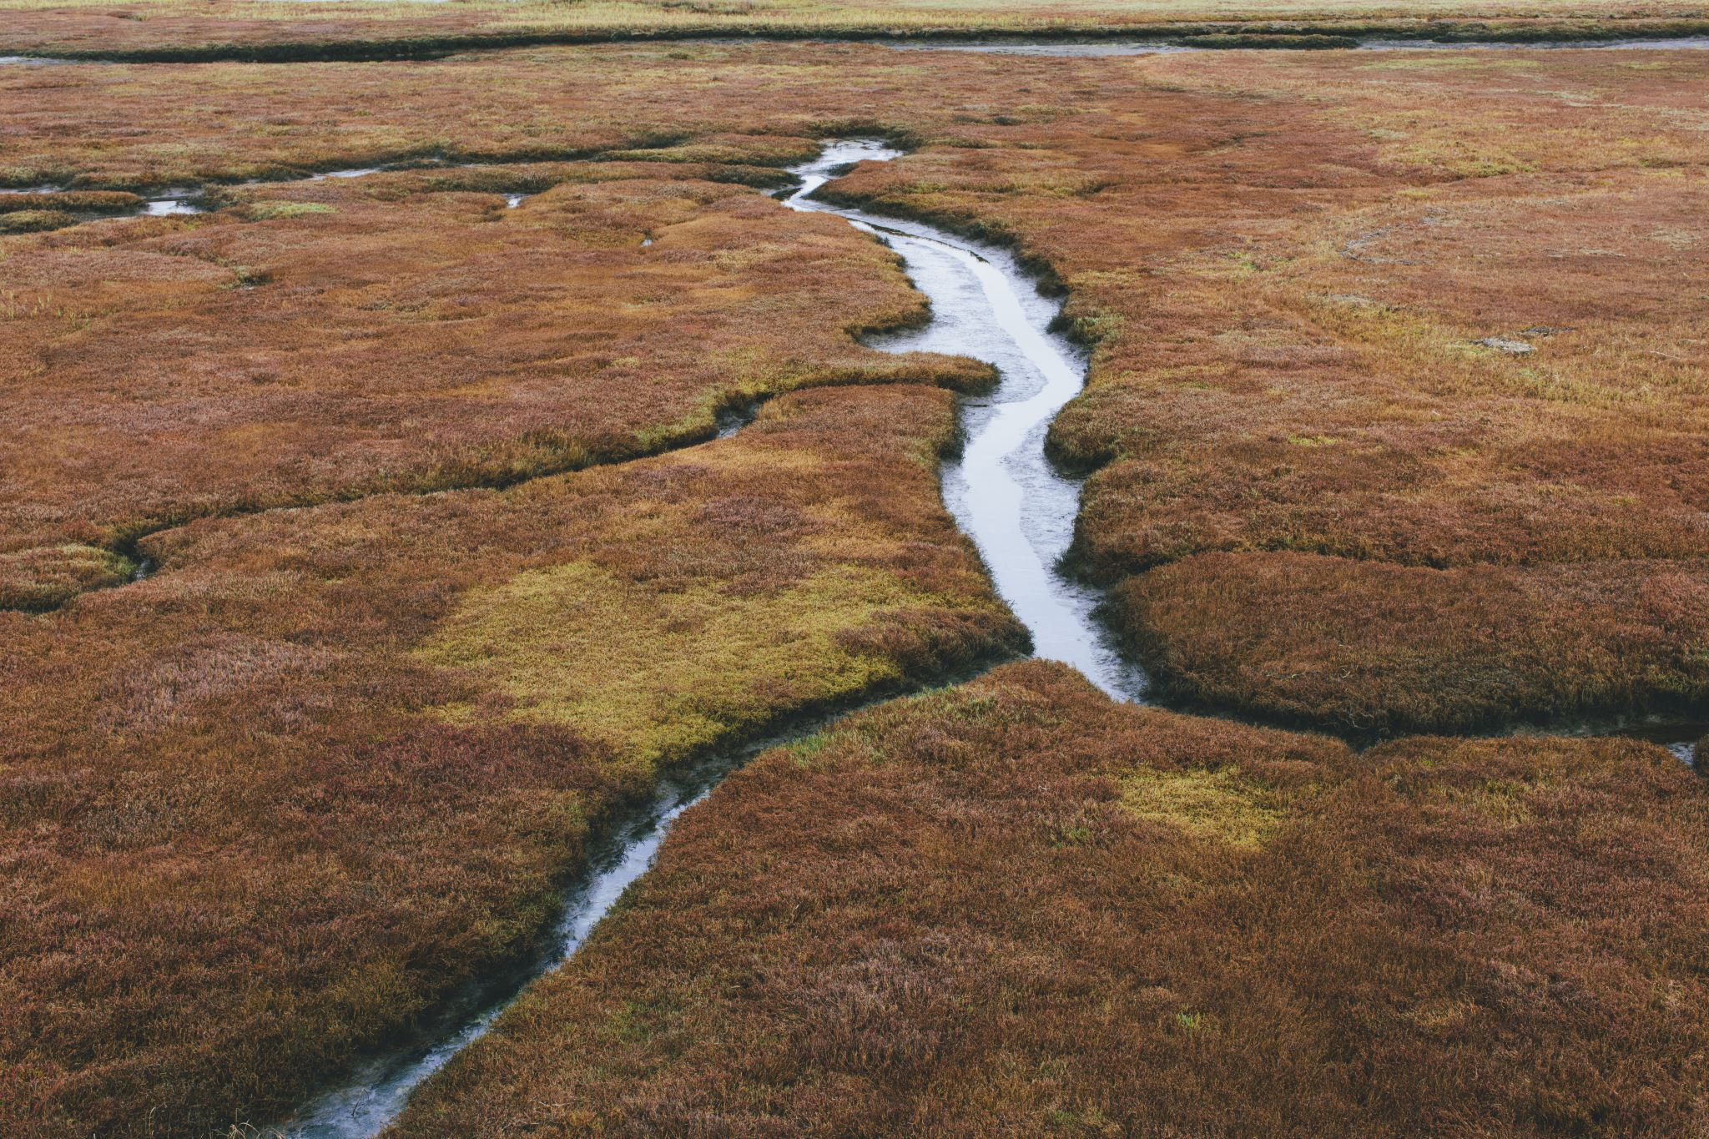
Droughts and Deep Waters A Data Science Exploration of Dynamic Water Rights and Vulnerabilities in the Upper Colorado River Basin
May 17, 2021
Ananya Gangadhar (ag757)

Slide 2
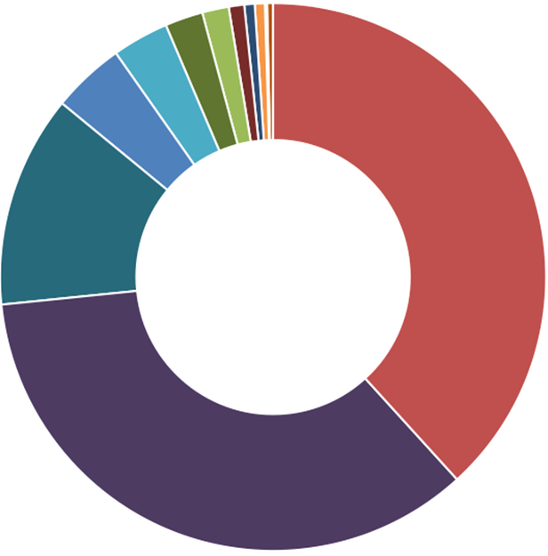
UCRB Basin Crash Course
9916 sq.miles basin area
Experiencing 20-year drought
Senior most calls
Grand Valley Area
Shoshone Power Plant
Fisheries
Storage
Irrigation
Transbasin diversion
Power generation
From Antonia’s CEE 6200 Guest Lecture
Notes:
From Upper Colorado Basin Information, 2007

Slide 3
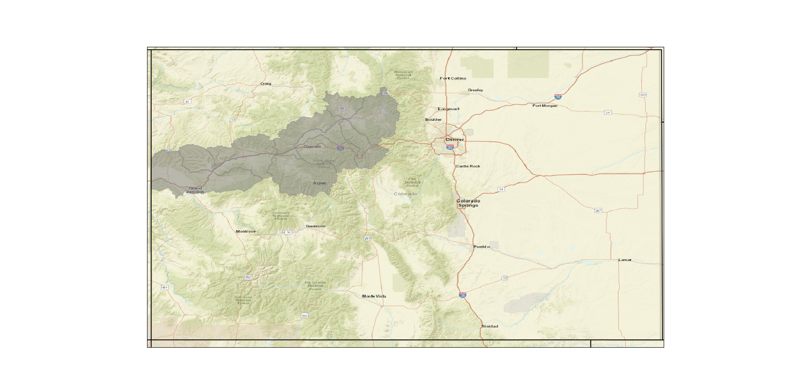
The goal of this project
…is to create a novel visualizations showing
hitherto unstudied interactions between water rights of thousands of diverse users UCRB, and
their evolution over time to help inform water resource management policies under deep uncertainty.
Utah ↑
UCRB
From Antonia’s CEE 6200 Guest Lecture

Slide 4
Data collection

Slide 5
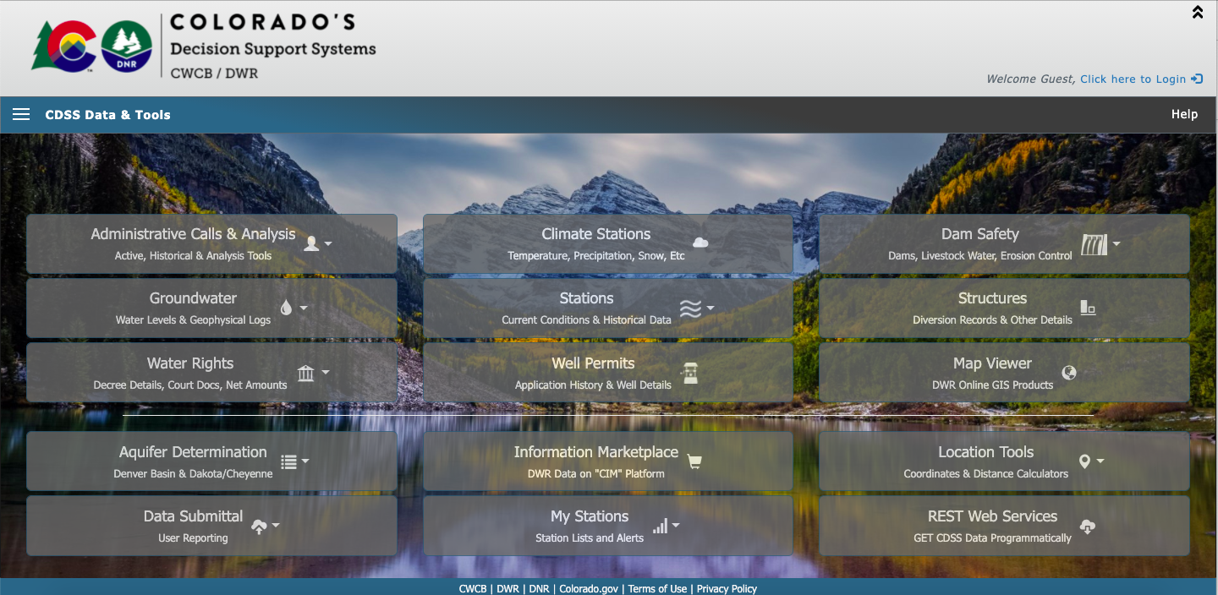
All data came from CDSS
Data collected
Water rights
Structure call
Streamflow
Climate

Slide 6
Set up automatic collection using Python
Checks downloaded data
Creates new subset of stations
Creates and submits API requests
Stops before subset exceeds CDSS limit
Saves .csv file to directory
SUCCESS

Slide 7
Visual exploration of data

Slide 8
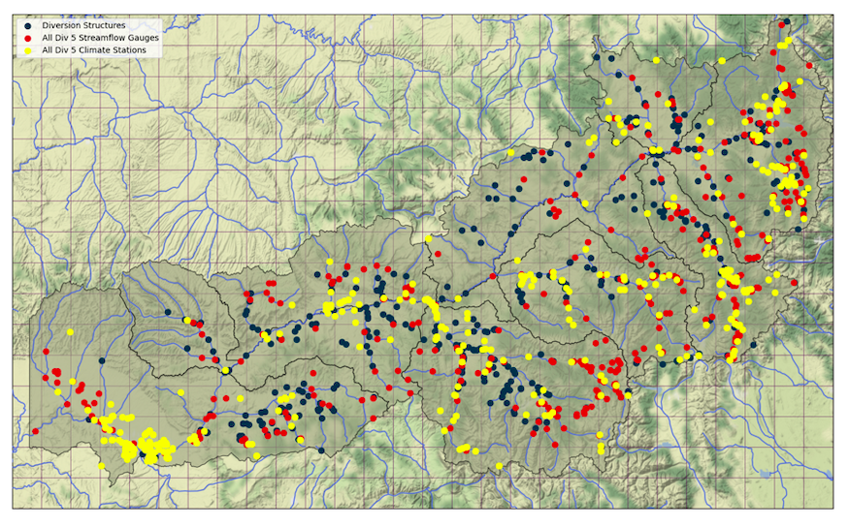
Mapped distribution of gages and users

Slide 9
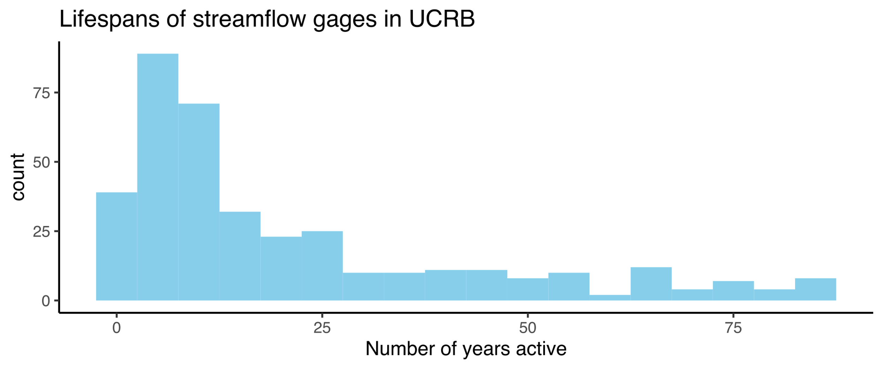
Gages have varying life spans
Dynamic nature of hydrological data can present a challenge

Slide 10
PCA on user monthly shortages

Slide 11




439 modeled users from 1908-2013
Removed users with no shortages
Ran PCA and plotted results
Bisected dataset into wet and dry years
Removed users with no shortages
Ran PCA for wet and dry years

Slide 12
Baseline PCA
PCA for wet years
PCA for dry years

Slide 13
Network maps in Python

Slide 14
Chose 2000-2019 as period of study
minimum
median
maximum

Slide 15
Made network maps by year
Directed graphs
Show SOURCE putting DESTINATION out of priority
100% of nodes shown
SOURCE
(e.g: Shoshone)
In_degree = 0
Out_degree = 2
DESTINATION
In_degree = 1
Out_degree = 0

Slide 16
Chose Priority WDID as source node
Location Wdid → The most downstream diversion structure that is controlling and diverting the entire available natural stream flow
Priority Wdid → The structure whose water right priority is the most junior diverter within the Call reach

Slide 17
Attributes
Node
Size → Allocation volume (cfs) of each user log-scaled
Color → Out degree of node in network
If out degree 0, white
Label → Structure name
Only important users labelled (out degree ≥ 20)

Slide 18
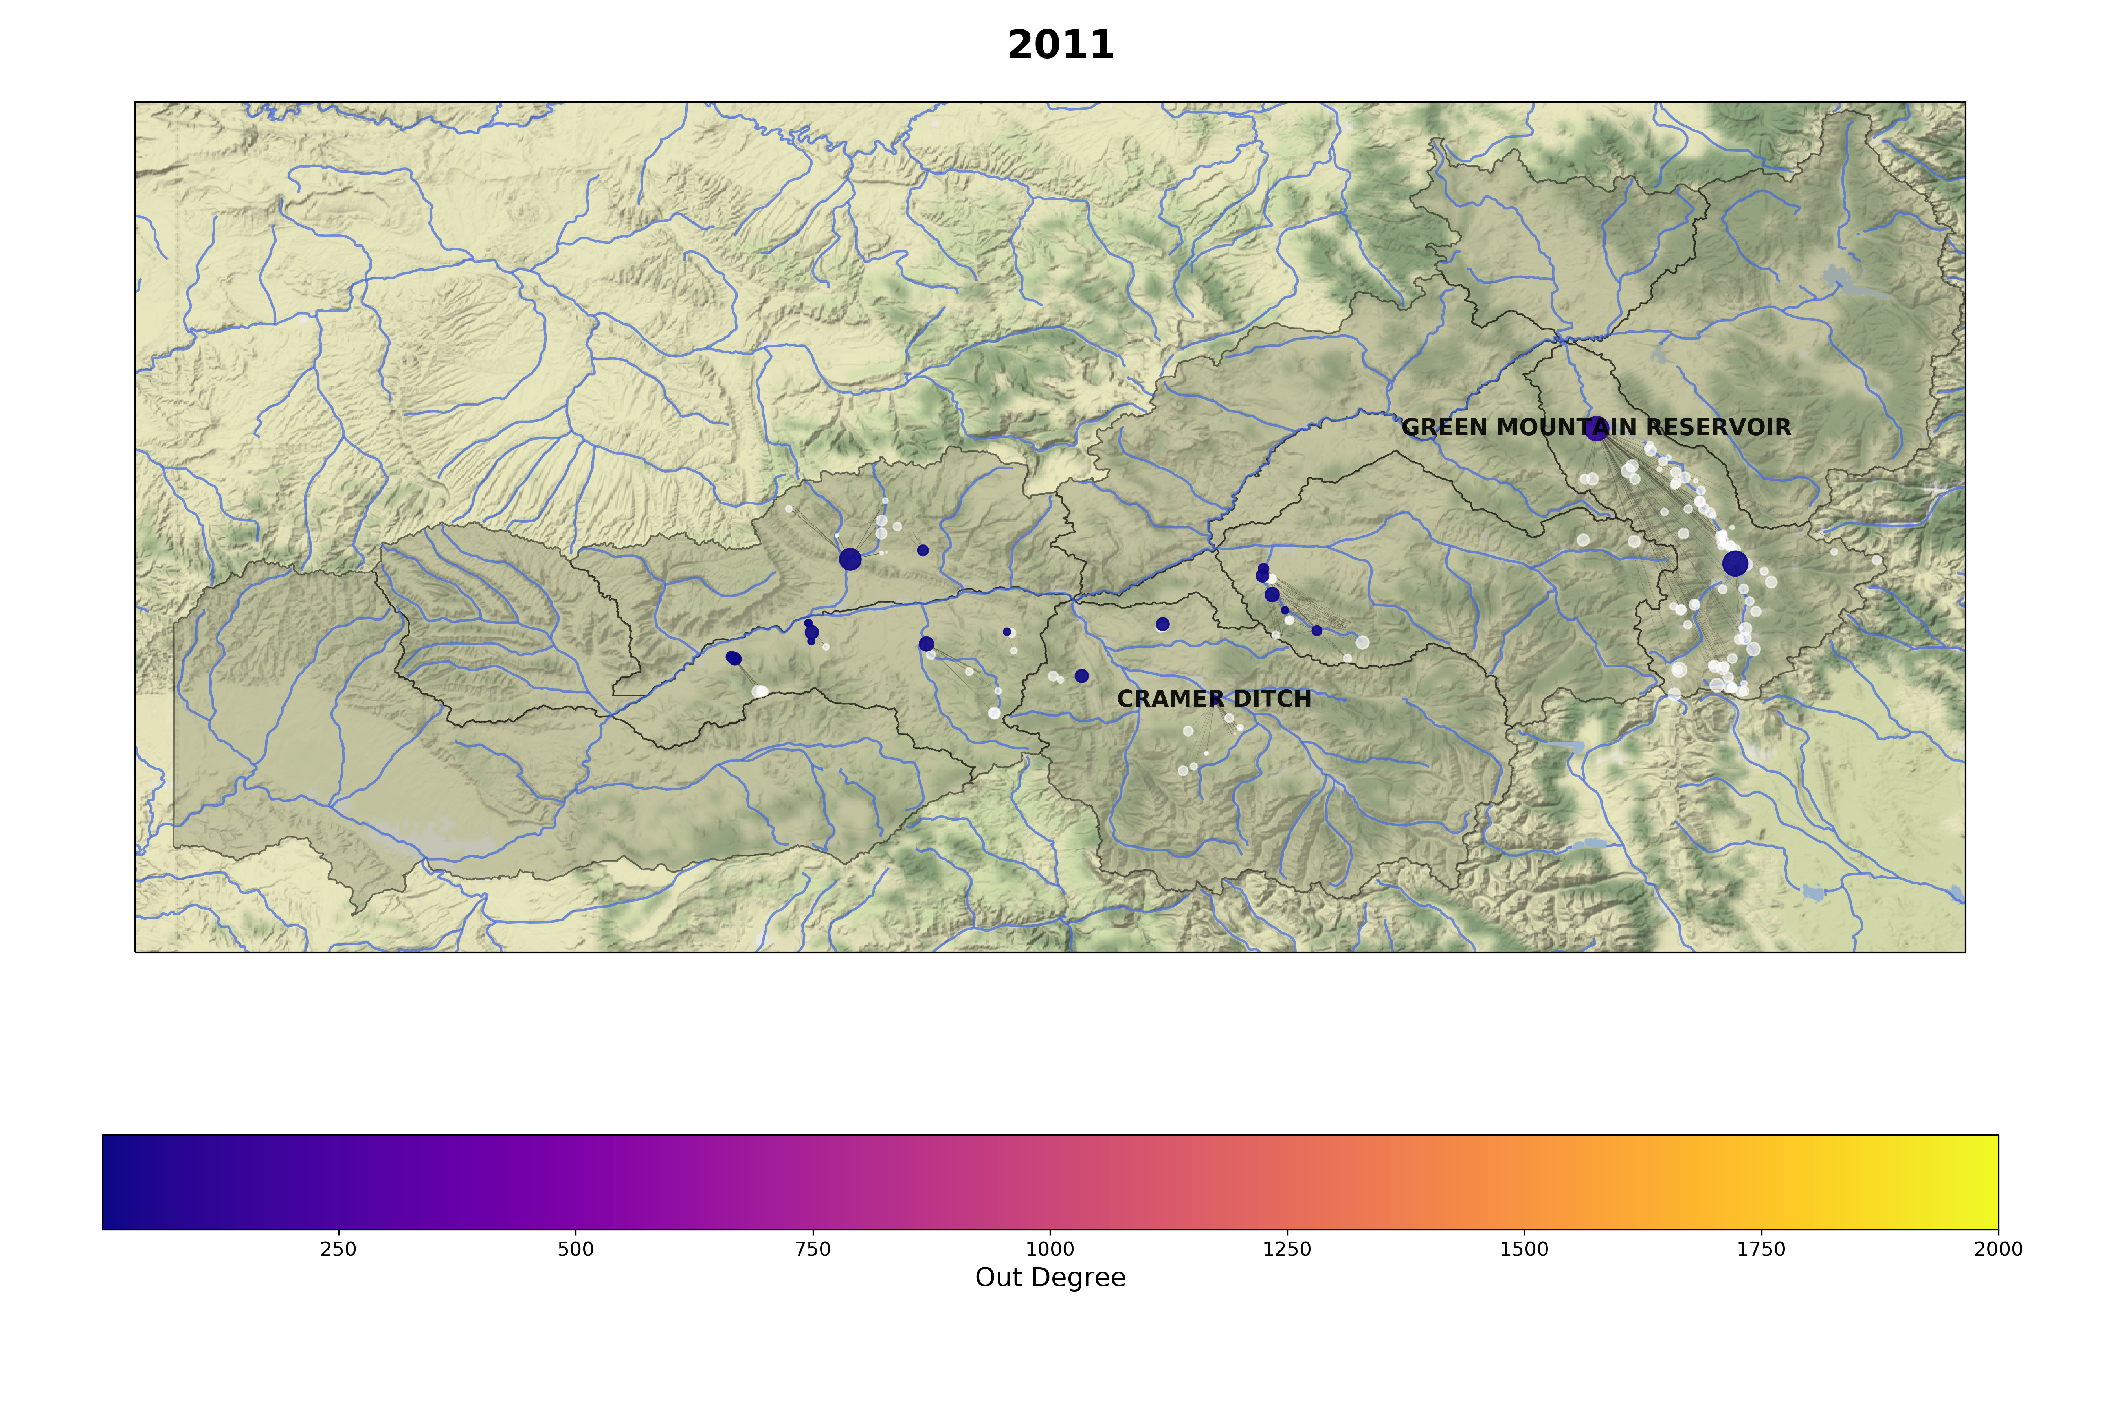
Maximum streamflow
Notes:
Wet year, not as many users needed to put calls, fewer connections

Slide 19
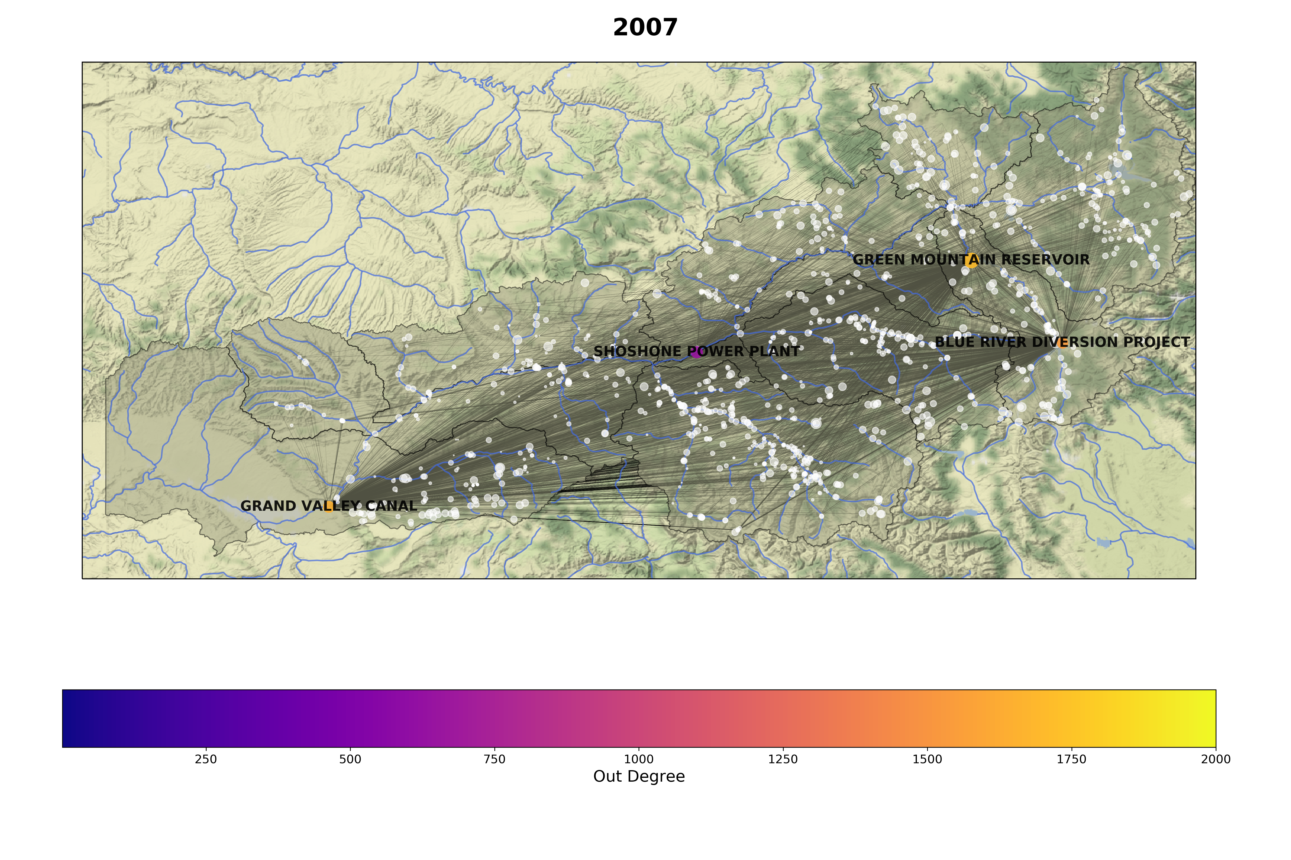
Median streamflow
Notes:
More stressed year, many more active calls

Slide 20
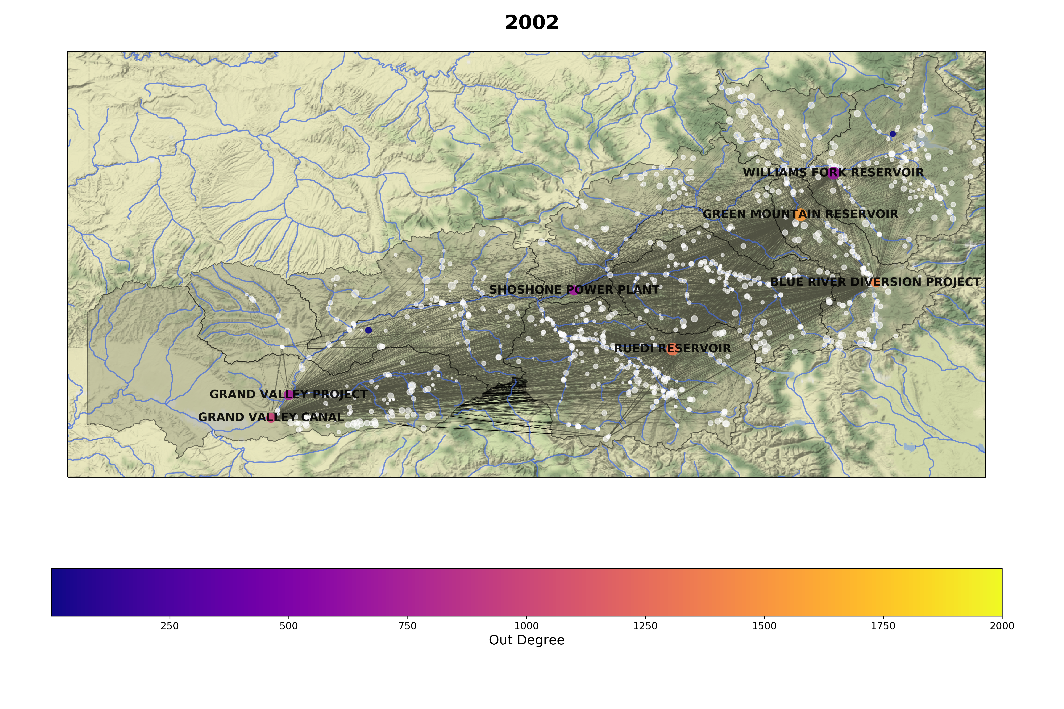
Minimum streamflow

Slide 21
Insights from geospatial mapping
Handful of senior users responsible for most of the calls put out
Leads to poorly connected networks
Fewer senior users need to put calls on others during wet years
Difficult to study individual interactions in this layout

Slide 22
Network visualizations in R

Slide 23
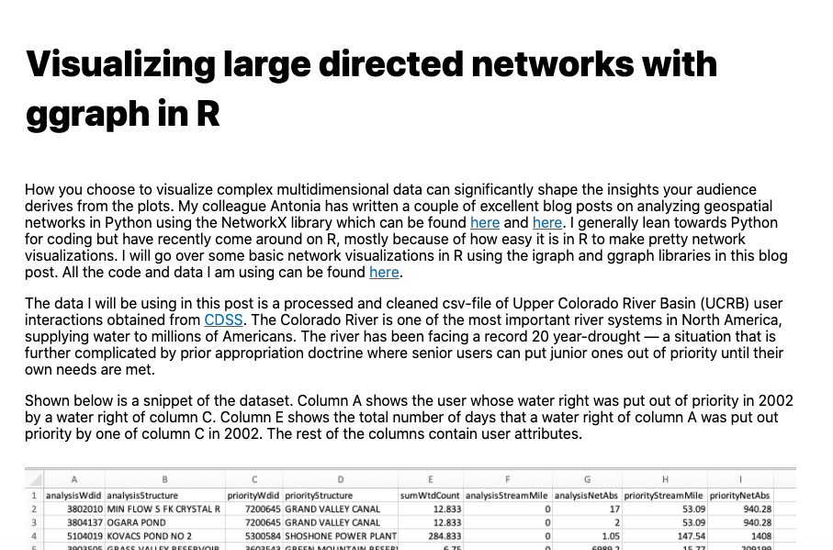
Selected 200 senior-most rights in UCRB
Created subnetwork to avoid cluttered visuals
Wrote a blog post about creating network graphs in R

Slide 24
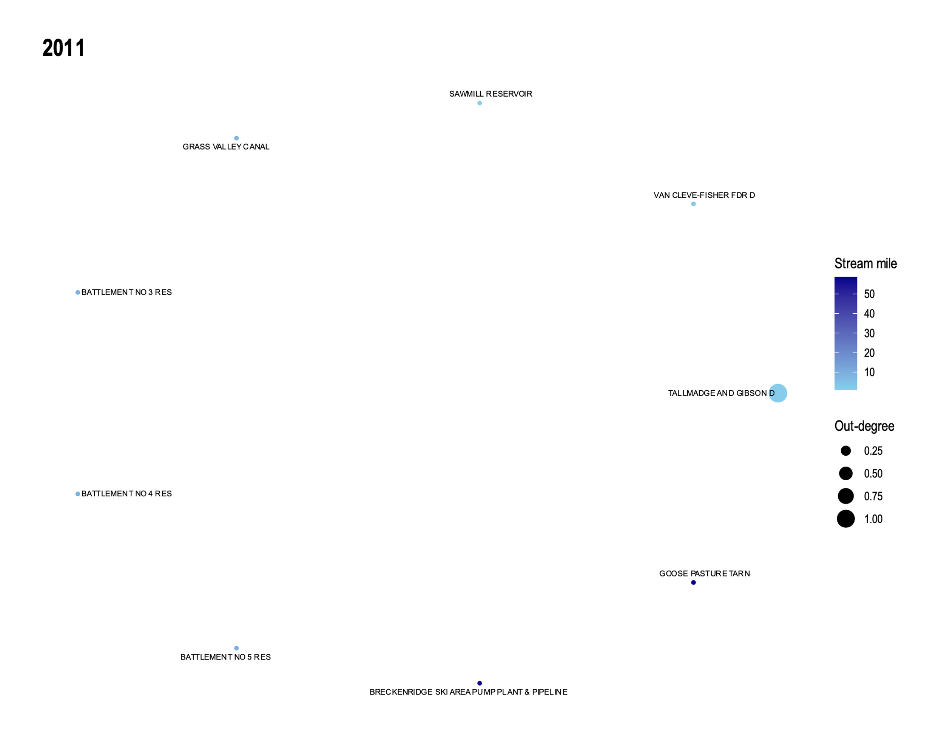
Maximum flow year

Slide 25
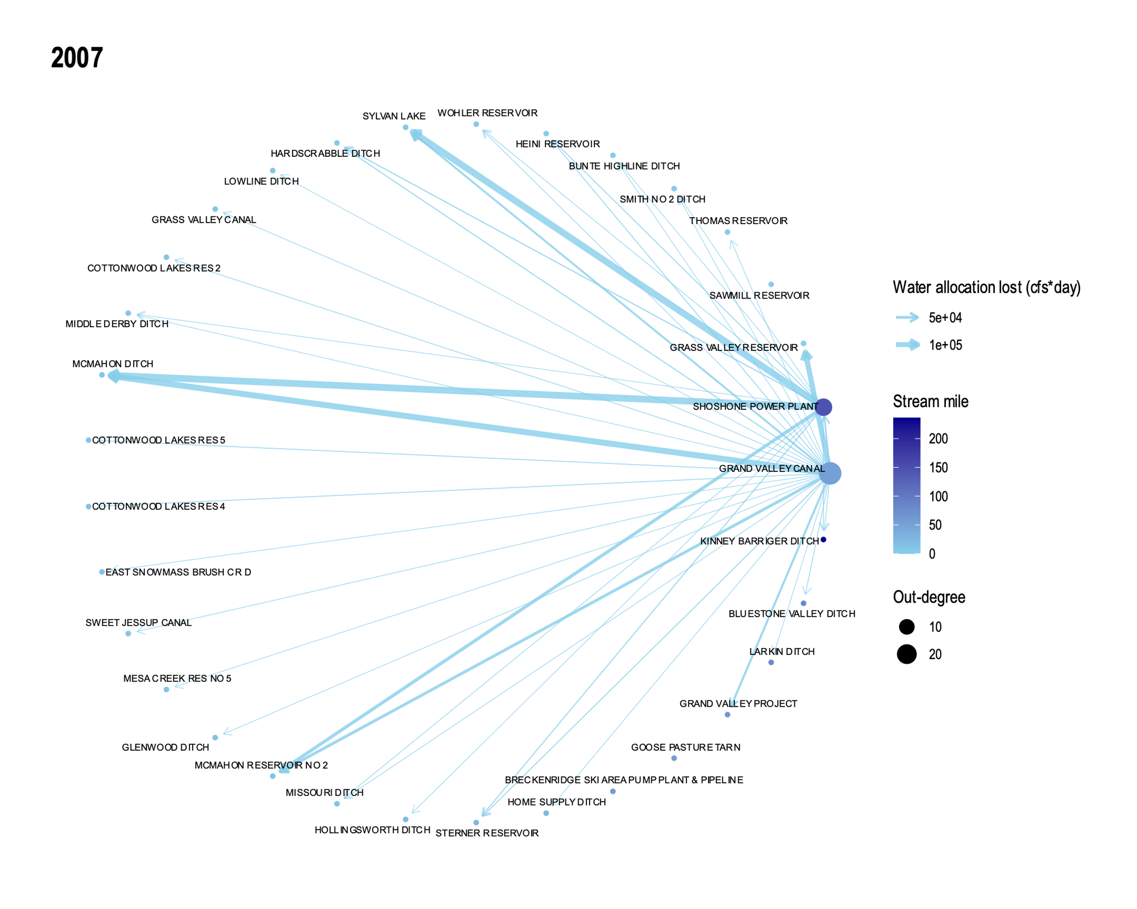
Median flow year

Slide 26
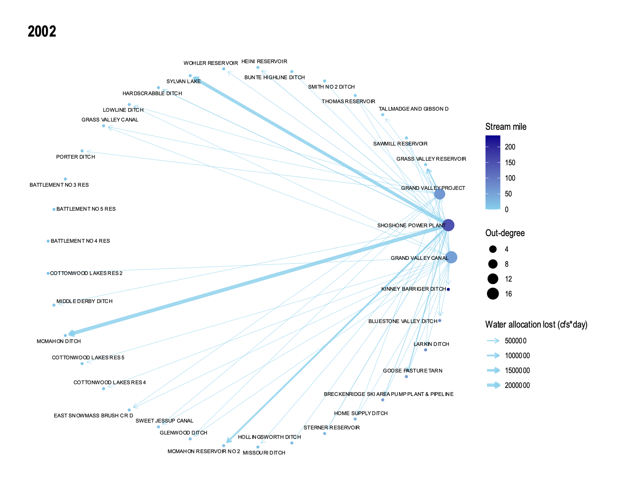
Minimum flow year

Slide 27
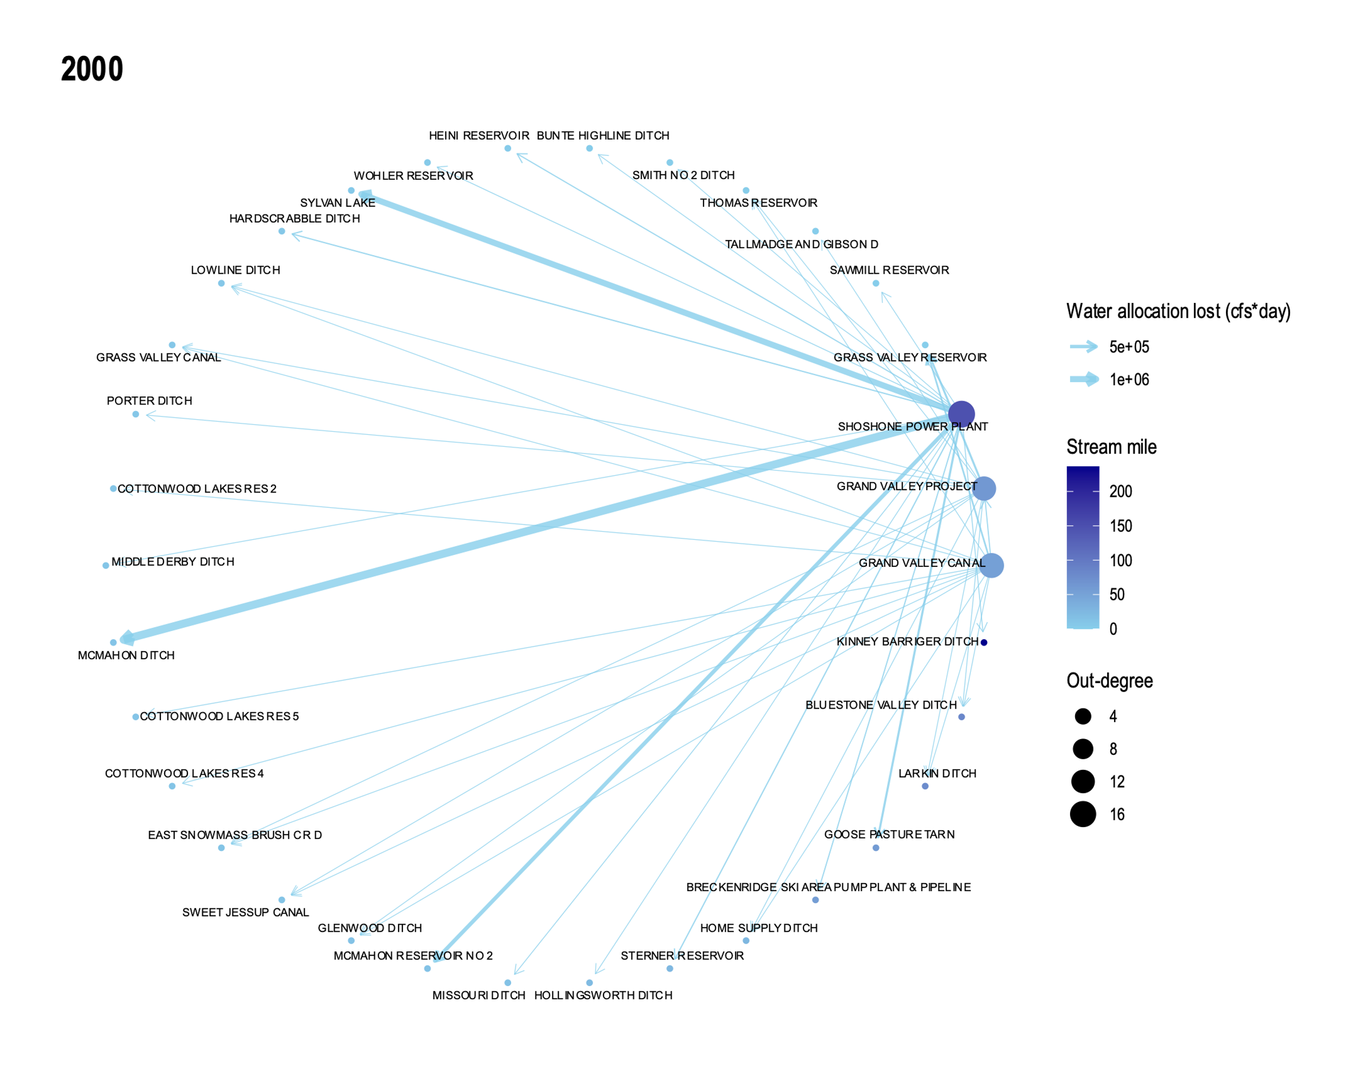
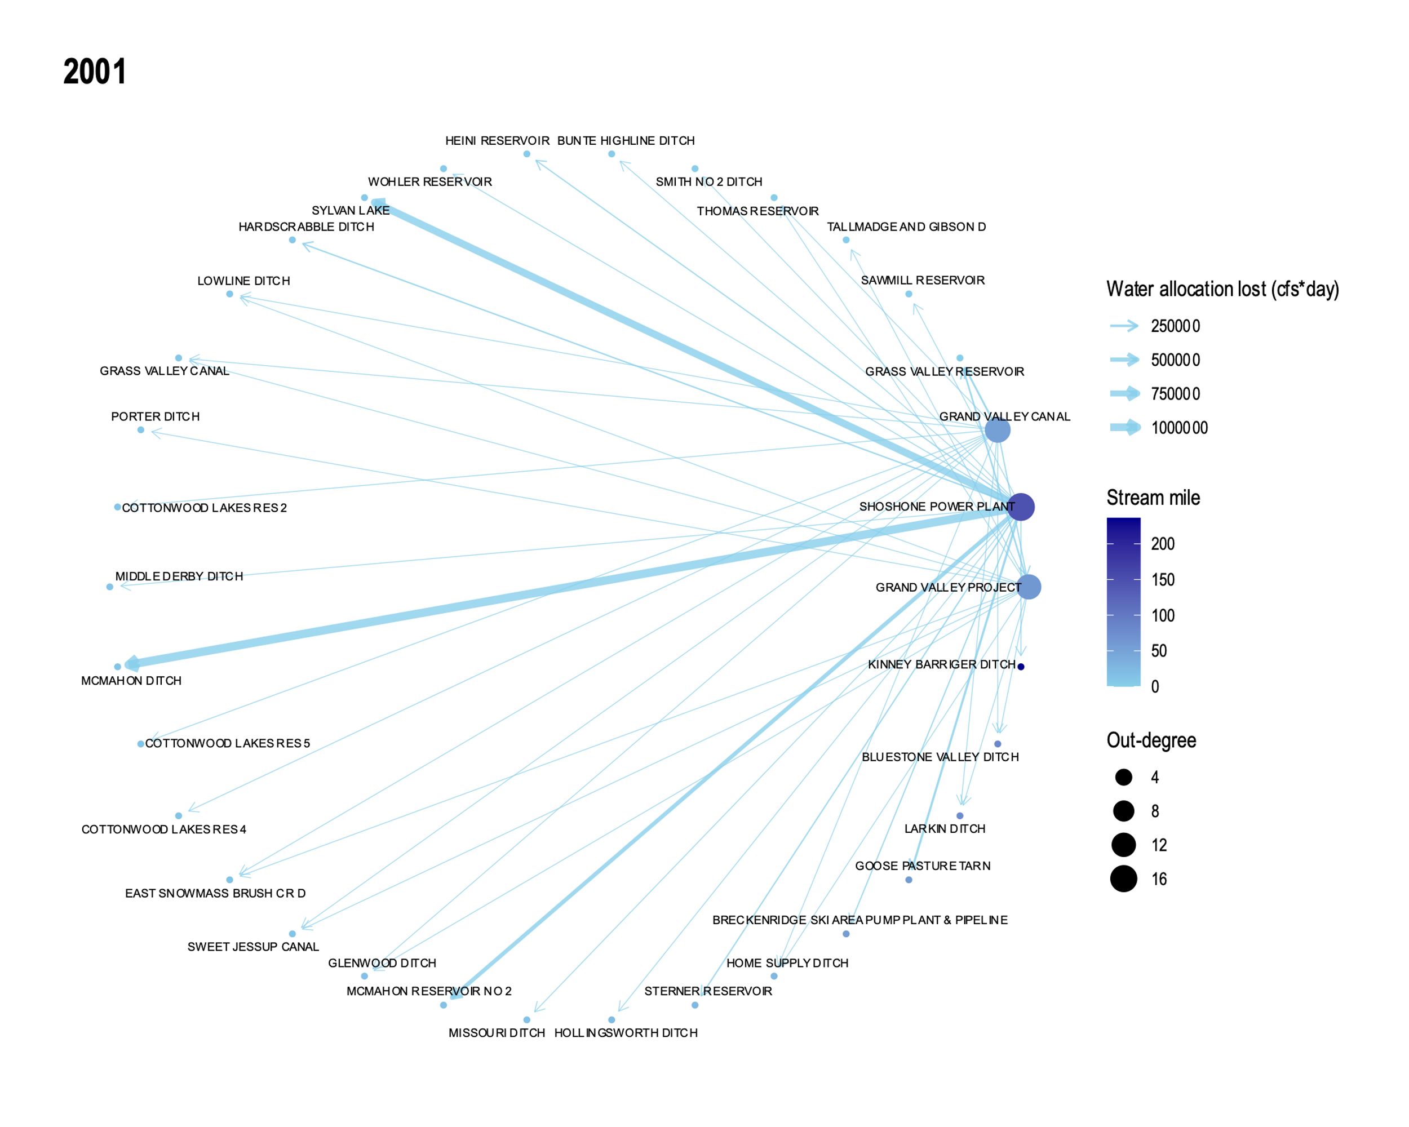
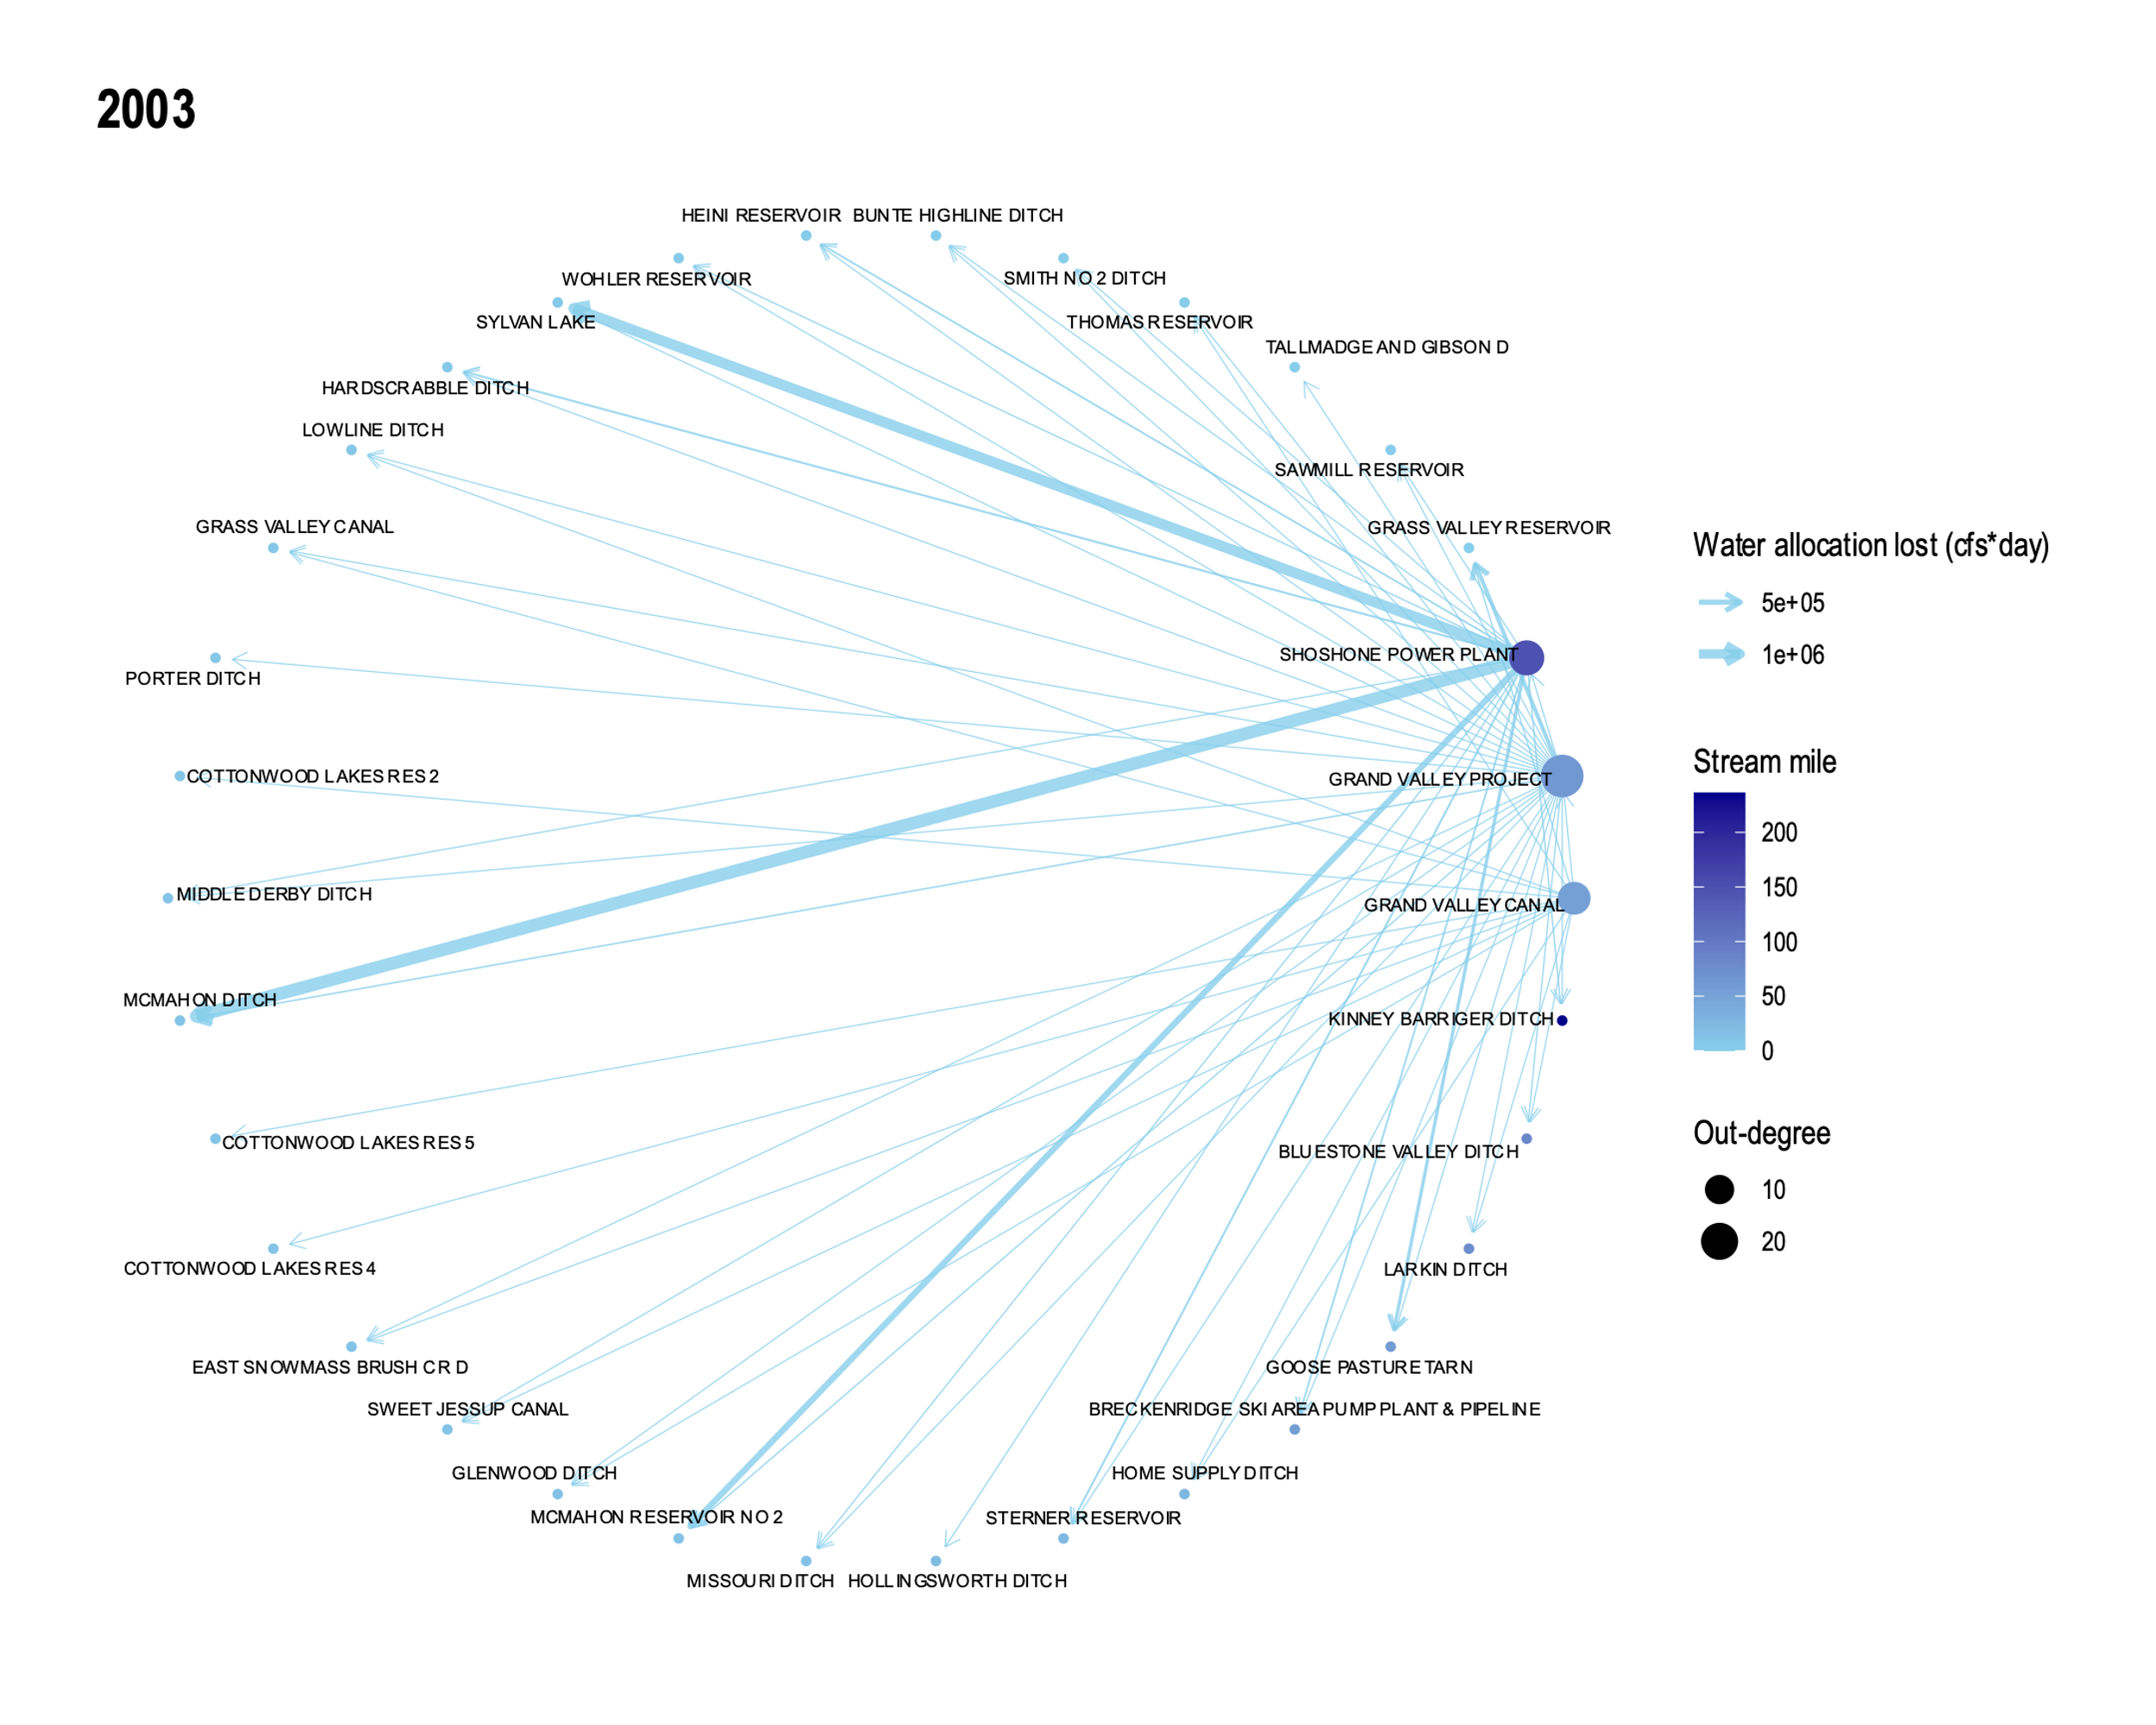
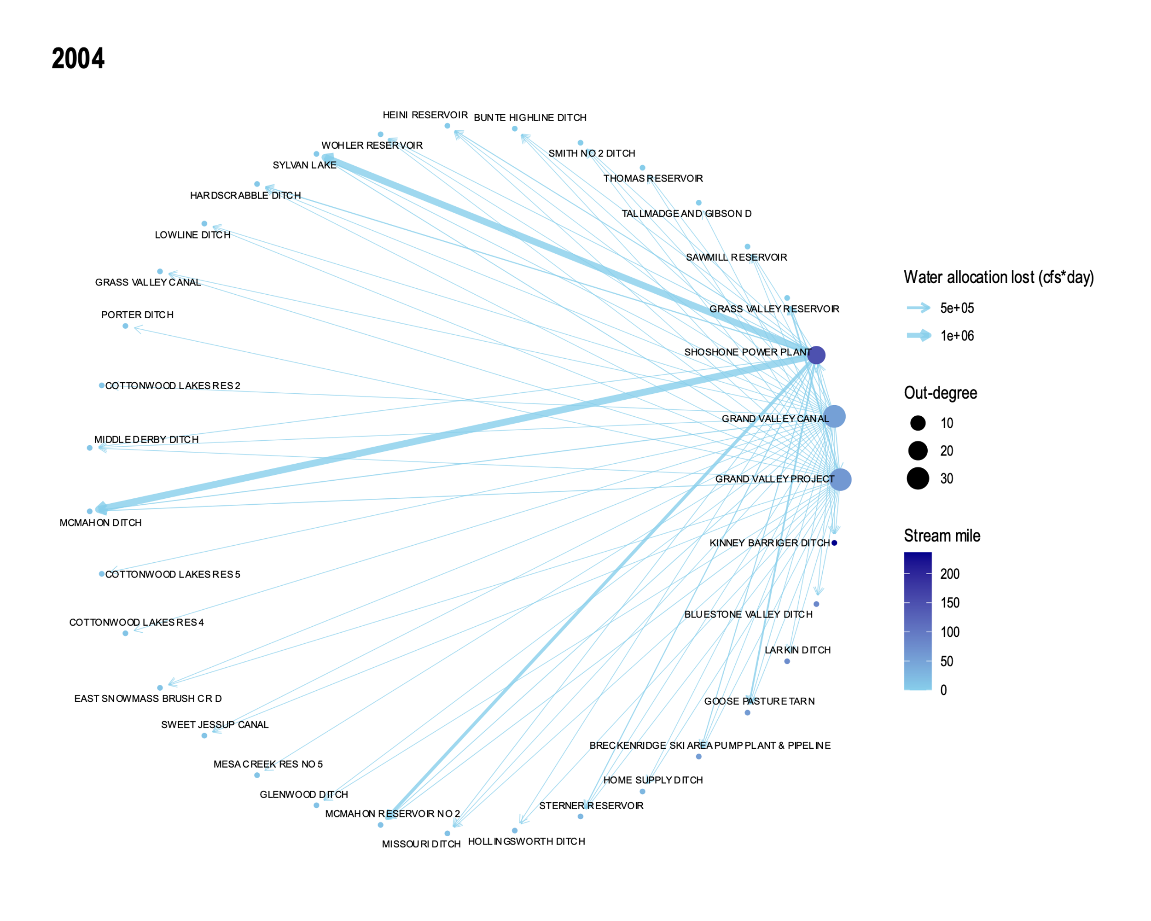
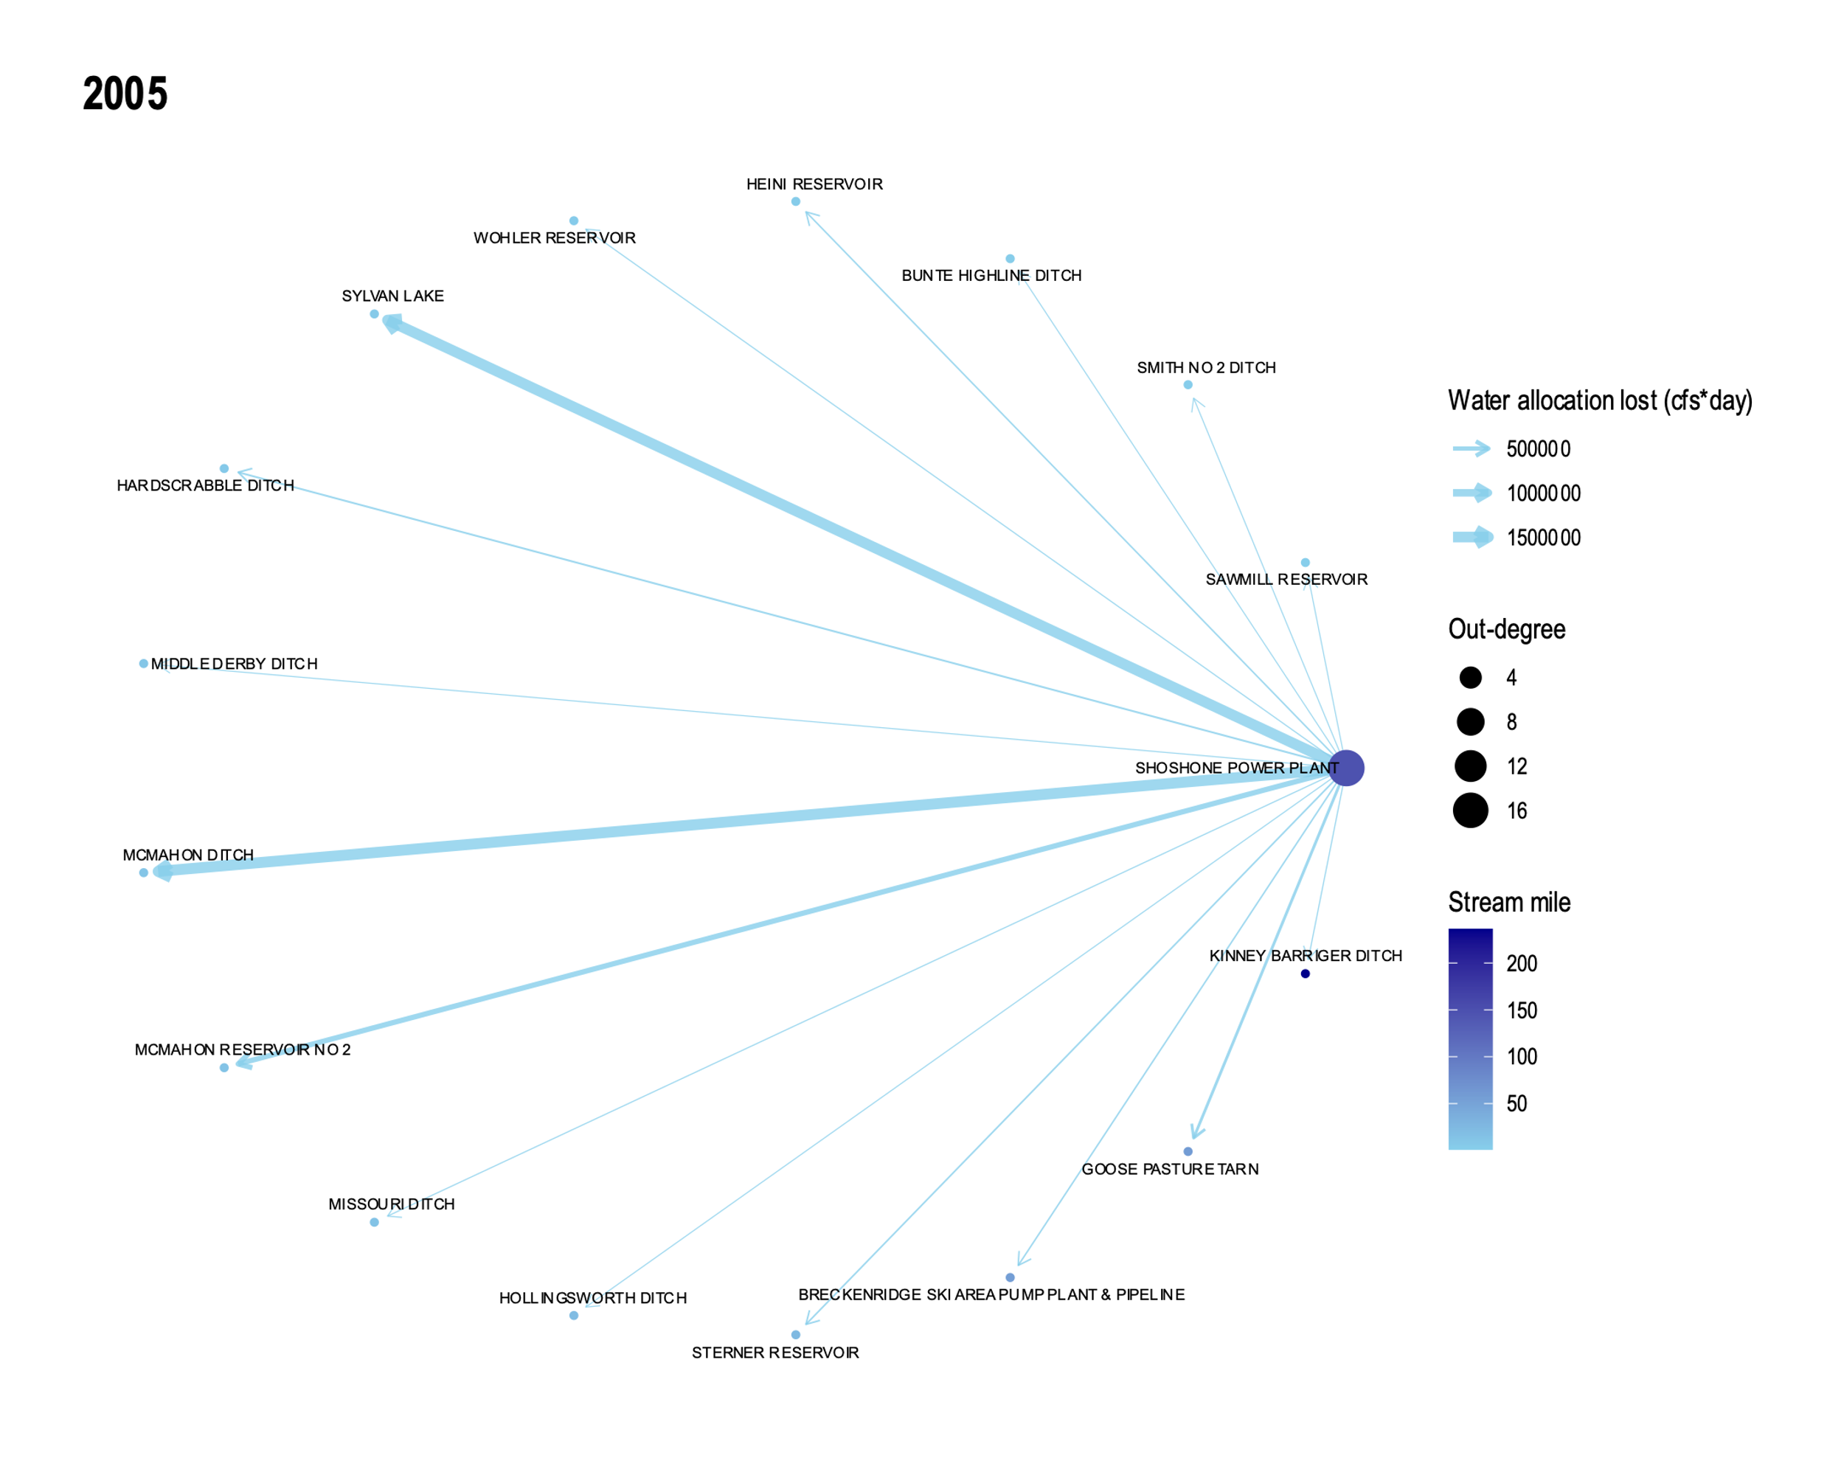
First 6 years in period of study

Slide 28
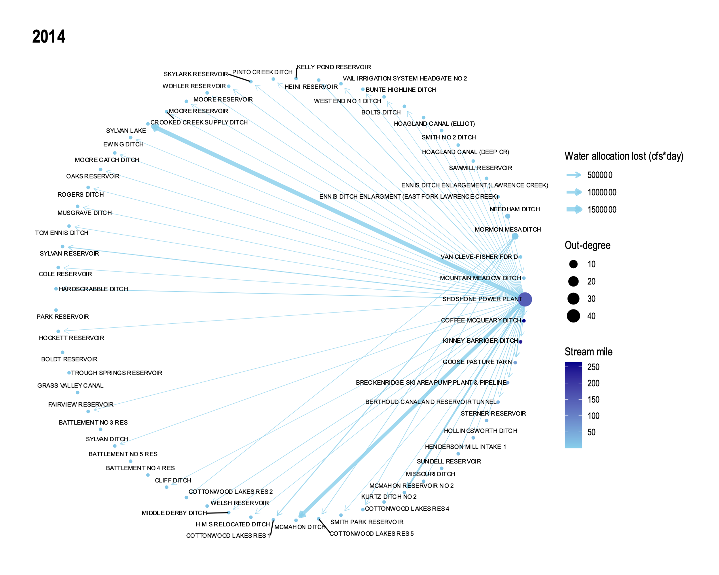
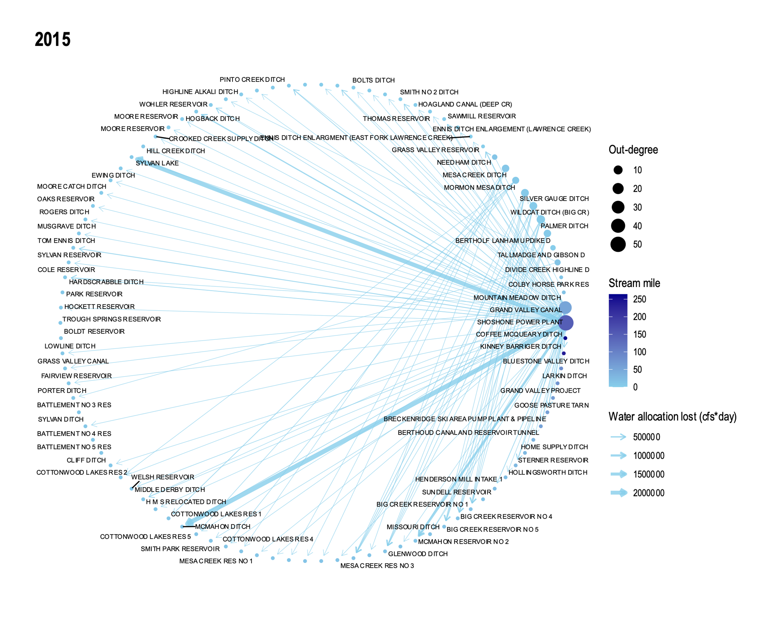
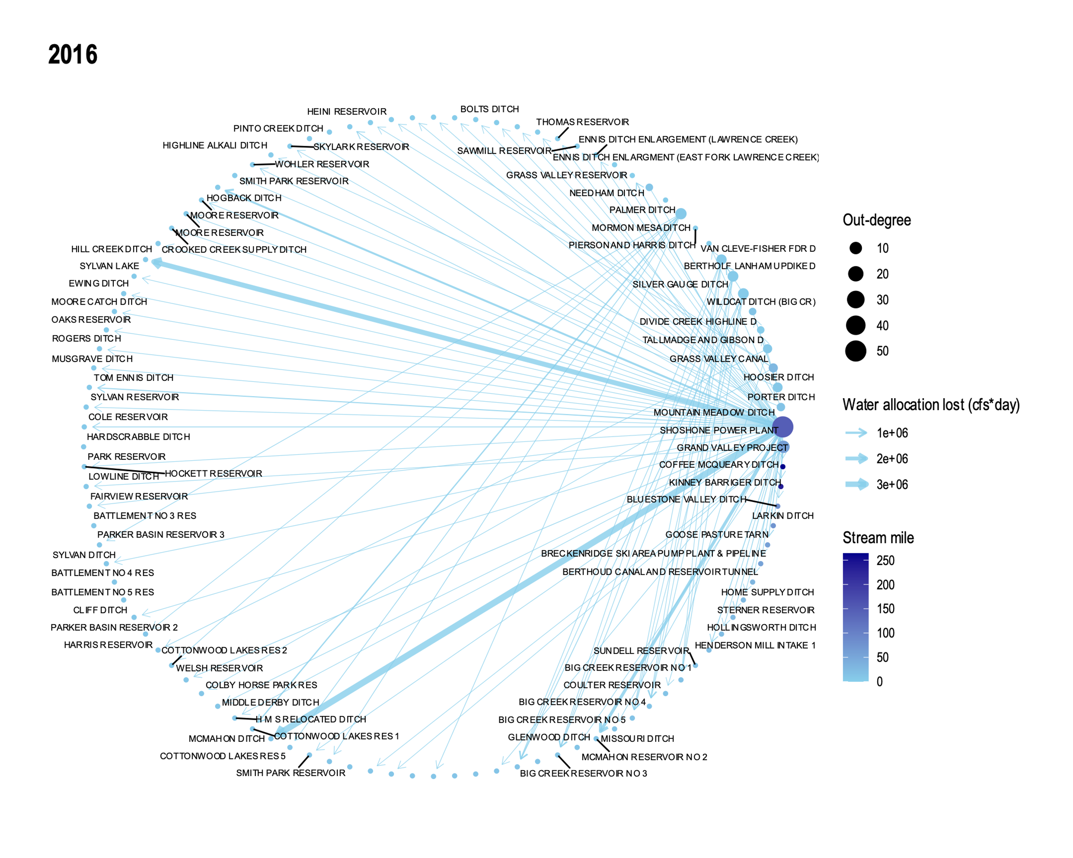
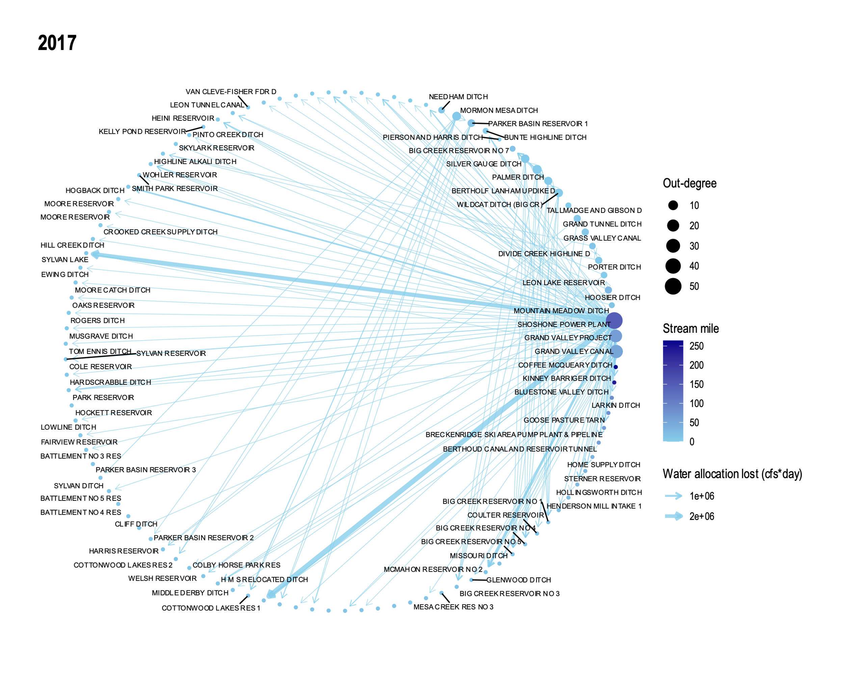
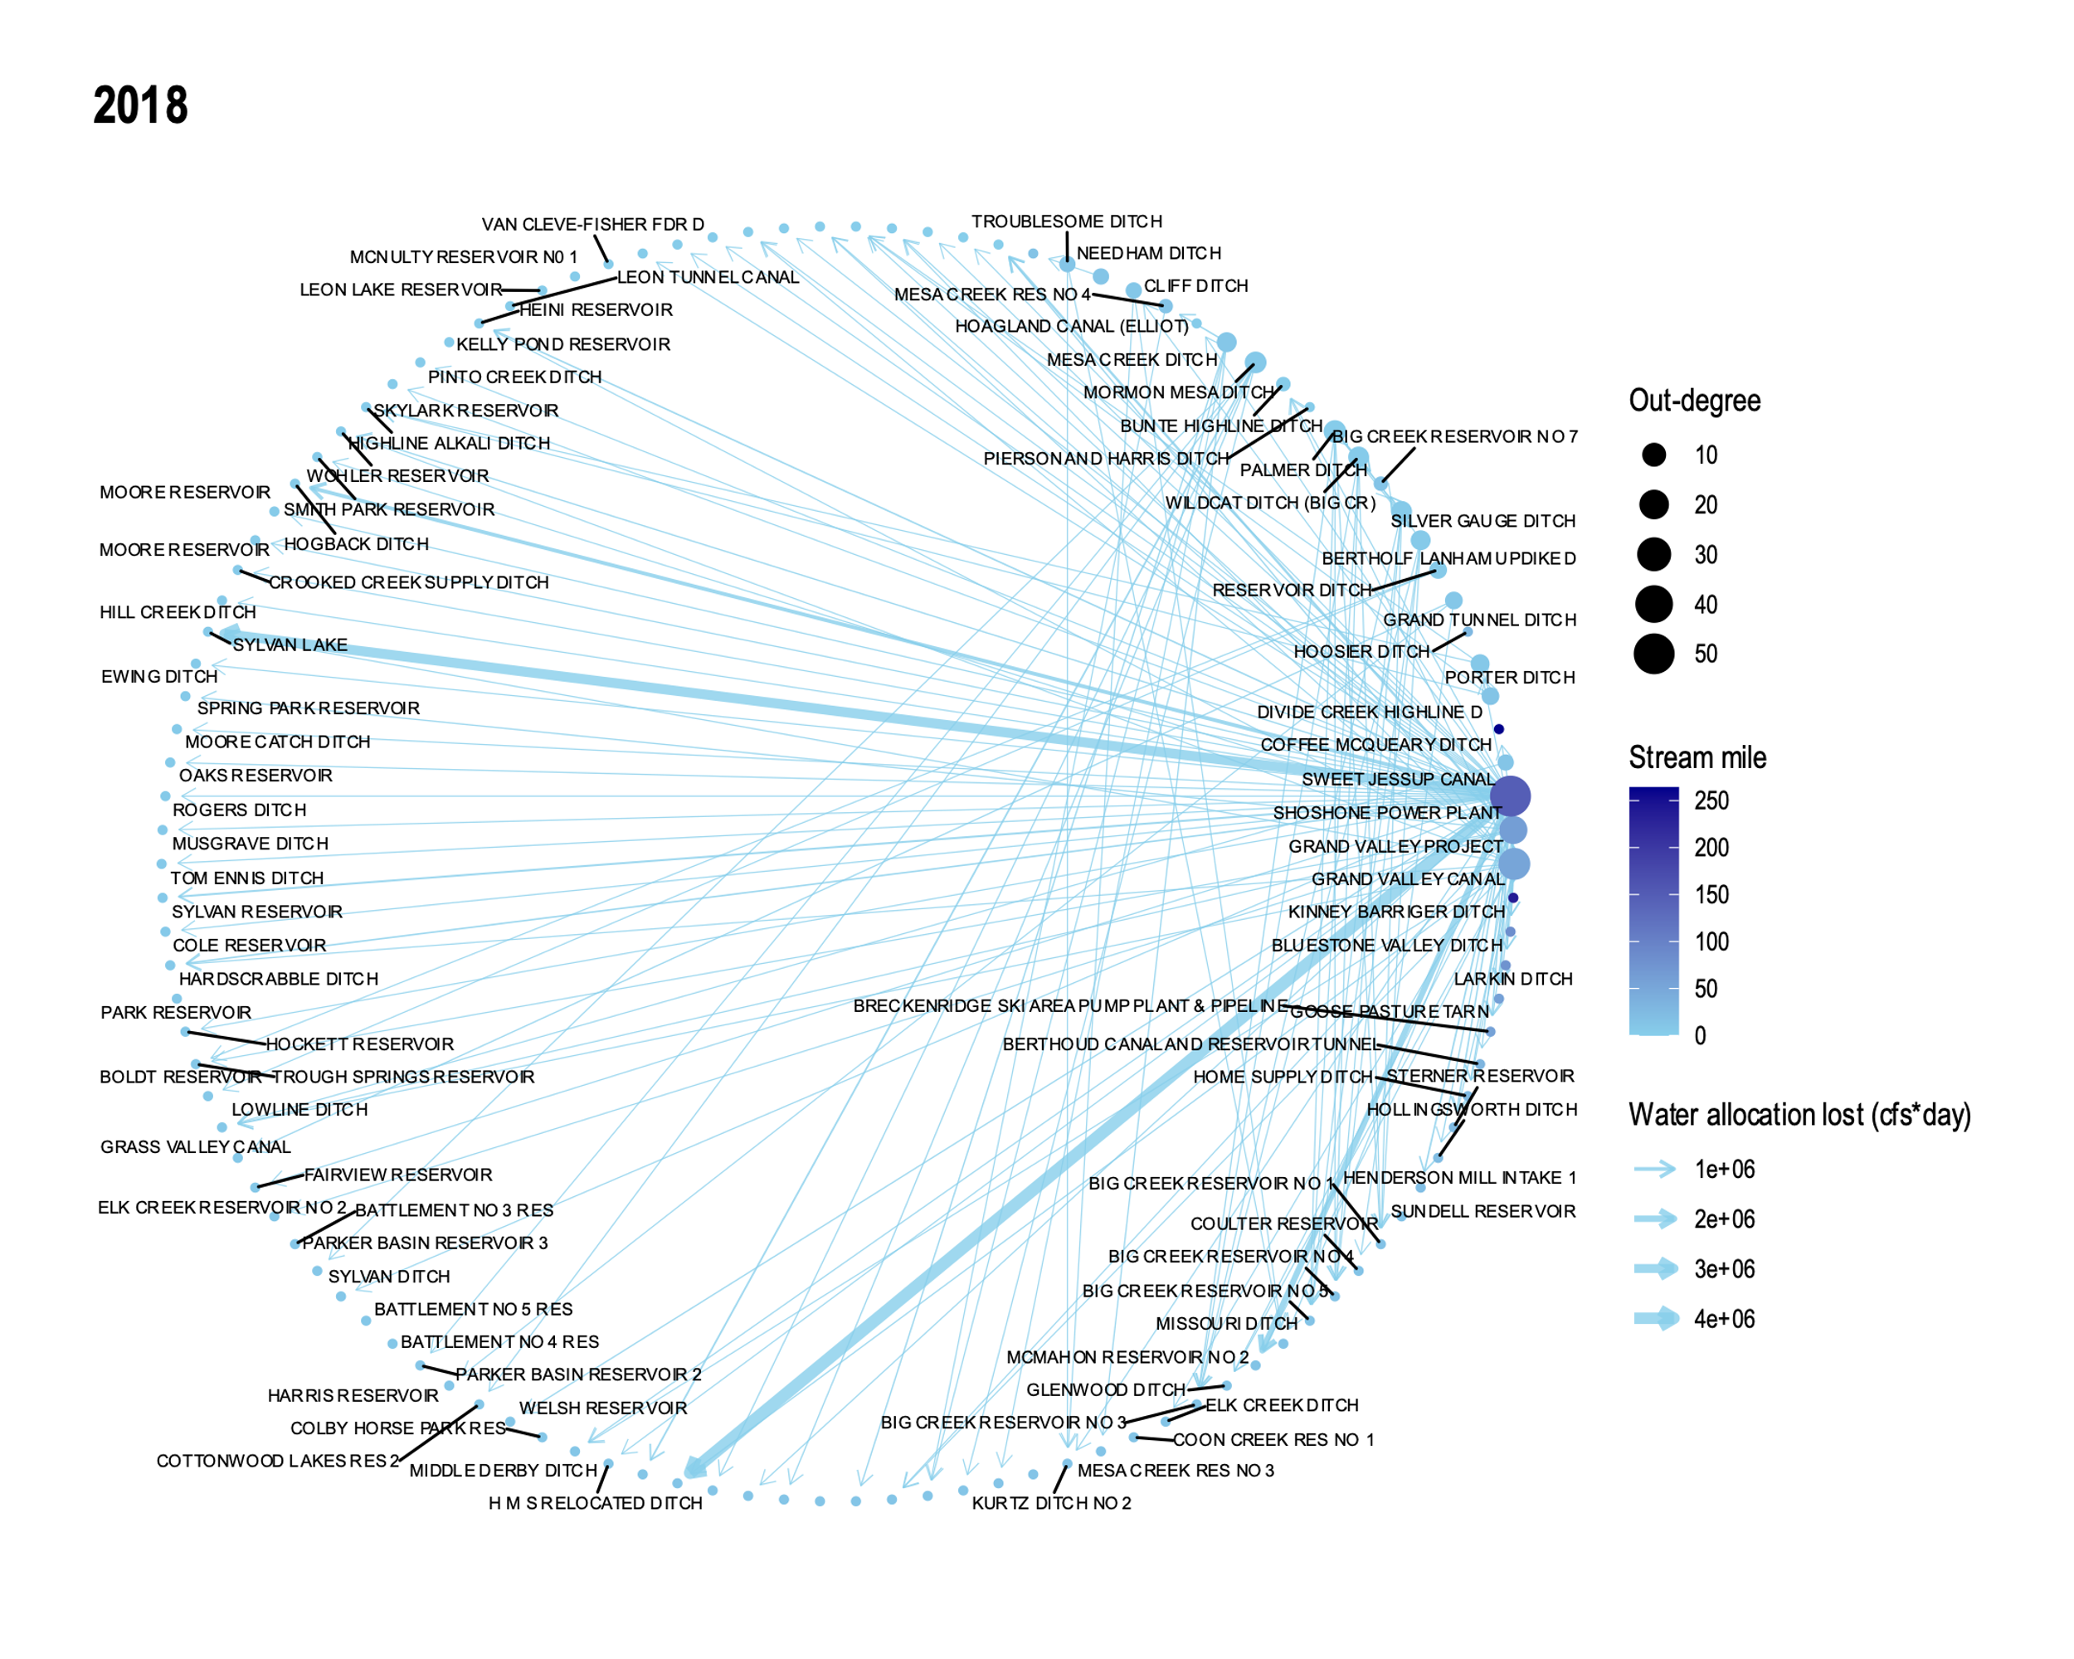
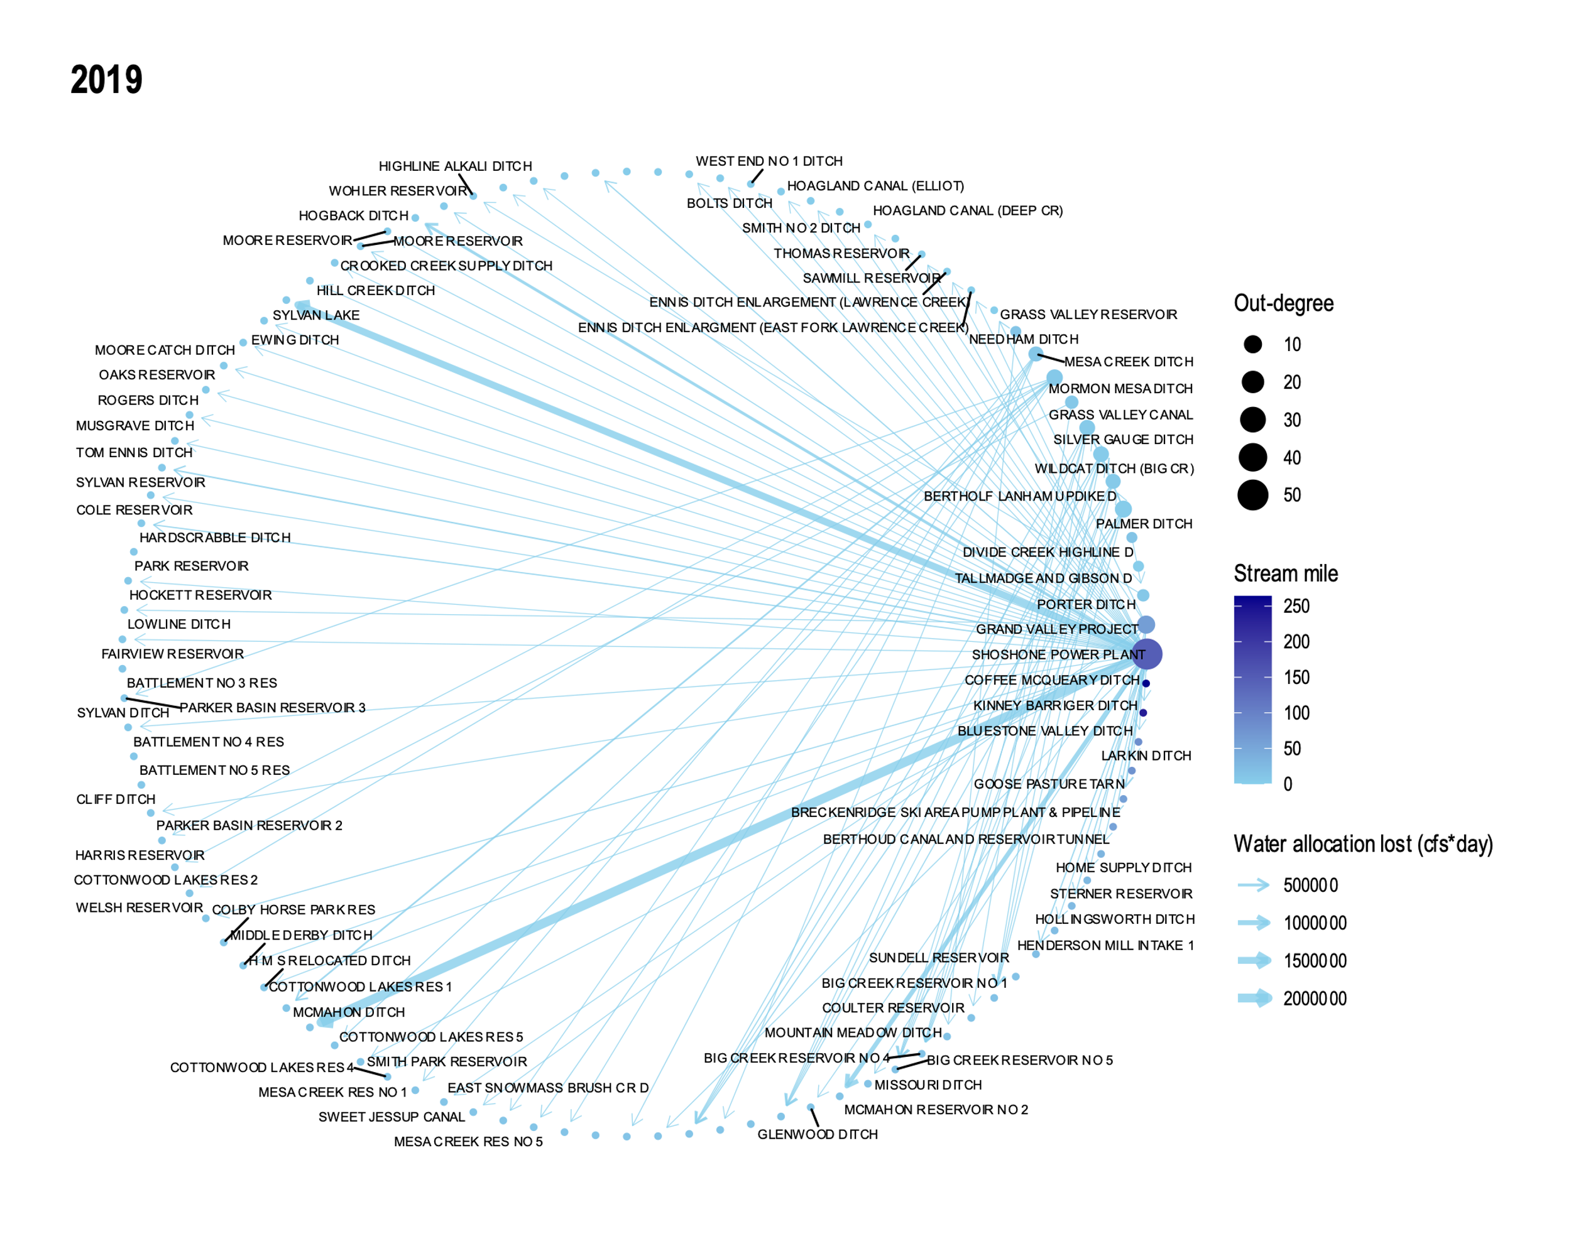
Last 6 years in period of study

Slide 29
Counted components
Number of components in full network
Does not correlate to streamflow

Slide 30
Counted number of senior users in network
Number of top 200 users = number of nodes in circular layout graphs
Not correlated to streamflow, but appears to be worsening with time

Slide 31
Observations
In 2000-2005
Far fewer senior users affected, even though 2002 was worst drought year
Fewer components in network
In 2014-2019
Around half of senior users affected
Many more components in network

Slide 32
Month-level analysis (2000-2003)

Slide 33
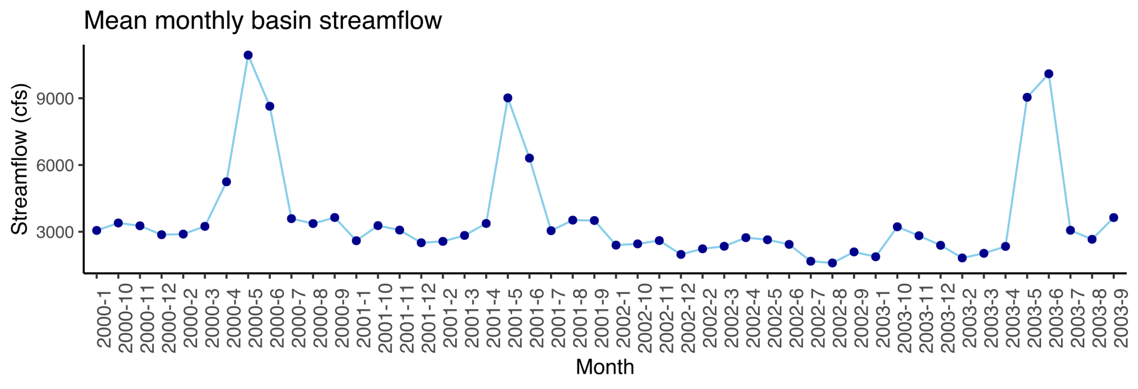
Looked at dynamics at month-level
Chose 2000-2003 for analysis
Created monthly networks instead of annual

Slide 34
Created a video showing the evolution
Video found under
Shortages_network/R_networks_scripts/monthly_analysis.mp4

Slide 35
Plotted number of components
Number of components in full network

Slide 36
Plotted number of senior users
Number of top 200 users = number of nodes in circular layout graphs
Correlated to number of components

Slide 37
Conclusion
Handful of important users
Networks become denser through time
Shortages caused by hierarchy combined with low streamflow
Same drought affects users differently

Slide 38
Future Work
Look at network dynamics over 100 years instead of just 20
Determine cause for increase in network components
Final M.Eng report due May 25

Slide 39
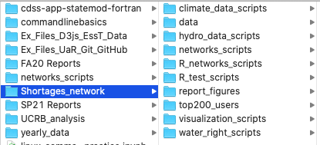
Work transfer
All code Github repository Shortages_network
All reports and presentations in Box folder

Slide 40
Thank you!

Slide 41
Extras

Slide 42
Skills I learned during this project
Python (pandas, matplotlib, networkx)
R (ggplot, igraph, ggraph)
Working with APIs
Data cleaning
Data visualization
Technical writing
Project management

Slide 43
Resources for plotting networks in R
https://www.jessesadler.com/post/network-analysis-with-r/
https://kateto.net/networks-r-igraph
https://www.data-imaginist.com/2017/ggraph-introduction-layouts/
http://mr.schochastics.net/netVizR.html

Slide 44
